Slide 1

Department of Electrical & Electronic Engineering
Rajshahi University of Engineering & Technology
TERAHERTZ IMAGING IN DOPED GERMANIUM-BASED HYPERBOLIC METAMATERIAL SLABS
Presented By
Supervised By
Ashraf Al- Khalique
Student ID: 1801171
Dept. of EEE, RUET
Dr. Md. Samiul Habib
Professor
Dept. of EEE, RUET

Slide 2
Presentation Outline
Thesis Background
Literature Review
Objectives
Methodology
Model and Results
Future Works
References

Slide 3
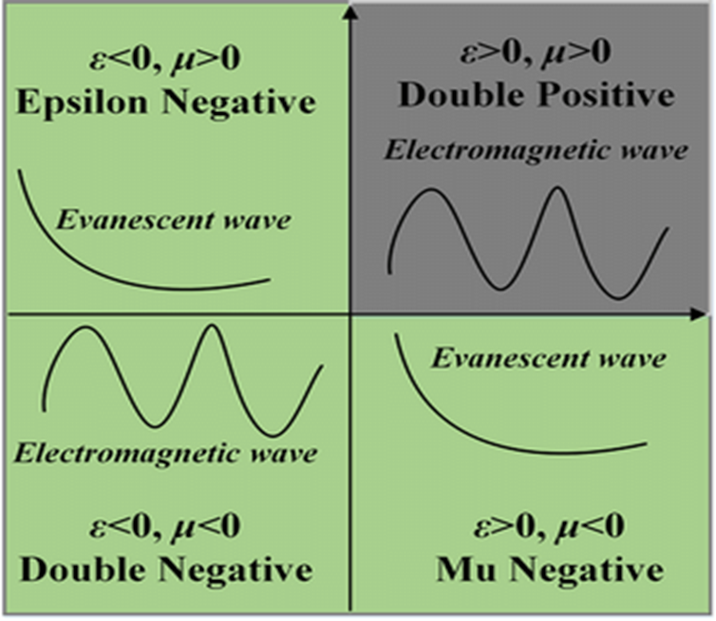
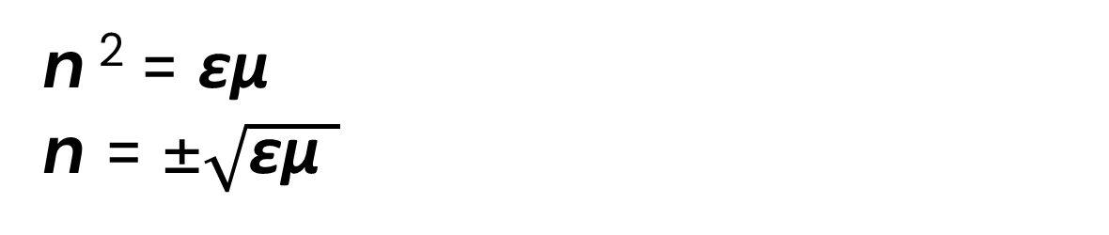
Thesis Background
Materials on ε and µ space
Metal
Dielectric
If ε and µ are both positive
n>0 (propagative wave)
If ε and µ are both negative
n<0 (backward propagative wave)
Which represents Metamaterial.
Refractive index
n ² = εµ
n = ±$\sqrt{\text{ε}\text{µ} }$
Metamaterial
Plasma

Slide 4
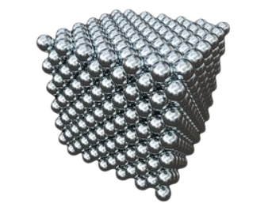
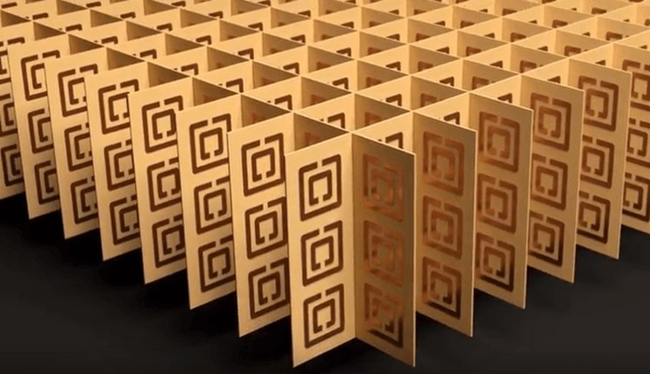
Thesis Background (Cont...)
What is Metamaterial
A composite material that is purposely engineered to provide material properties that are not otherwise attainable with ordinary materials.
Properties are derived from their physical structure, not their chemistry.
Thus metamaterials have both negative permittivity and permeability.
As a result, the refractive index (n) is negative.
Fig.01: Thorium as natural material
Fig.02: Metamaterial

Slide 5
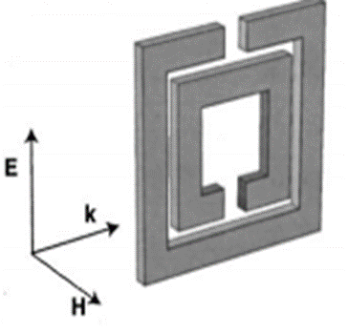
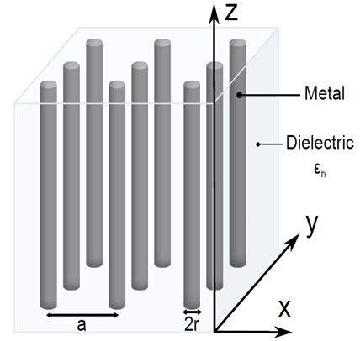
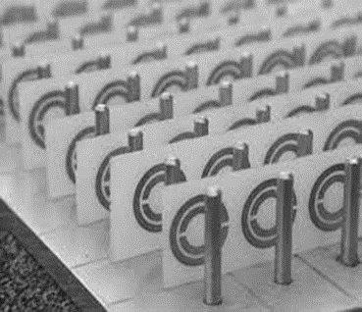
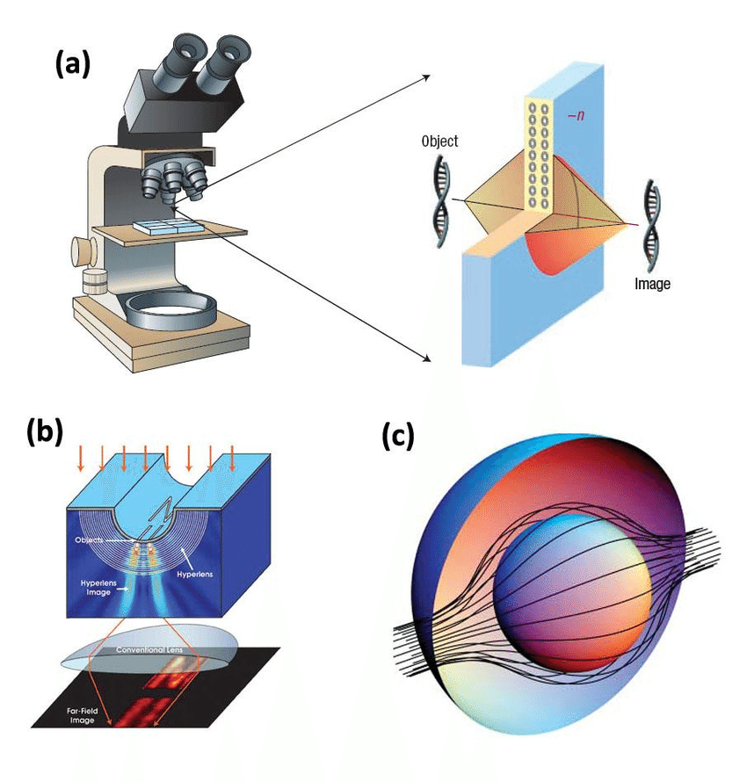
Thesis Background (Cont...)
Example of Metamaterials
µ < 0
ε < 0
ε, µ < 0
Fig.03: Split ring resonator
Fig.04: Wire array metamaterial
Fig.05: Composite metamaterial
Application of Metamaterials
Invisibility cloaks
Super-resolved imaging
Perfect absorber
Super Lenses
Bio-sensing
(a)
(b)
Fig.04: (a) Super lenses (b) Invisibility cloaks
Page | 5

Slide 6
Thesis Background (Cont...)
Hyperbolic Metamaterials
It has an extremely high anisotropy with a hyperbolic dispersion relation.
Hyperbolic metamaterial enables imaging of features smaller than the wavelength and surpass the diffraction limits.
For Anisotropic behaviour, the dielectric response is a tensor.
ε =[ε_{xx} ; ε_{yy} ; ε_{zz} ]
Where, In-plane components are ε_{xx} = ε_{yy} = ε|| & out of plane component is ε_{zz} = ε⊥
Page | 6

Slide 7

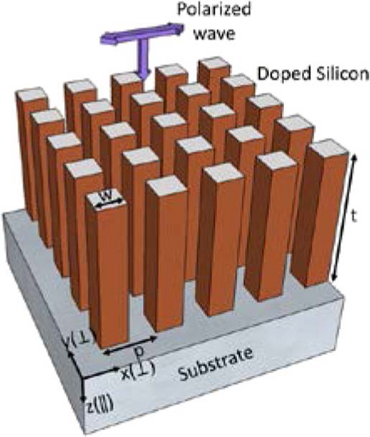
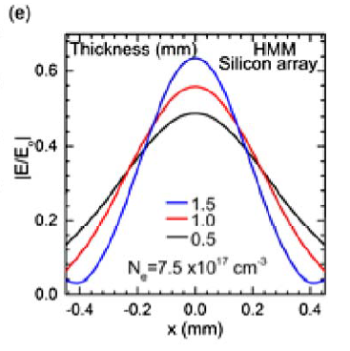
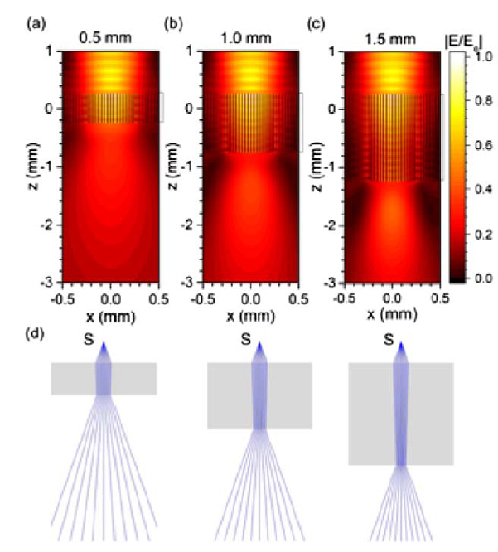
Literature Review
Contributions
Study on subwavelength focusing of terahertz waves
Utilizes effective medium theory
Calculates the permittivity of the doped silicon using a Drude model.
Research gaps
Comprehensive analysis
Practical applications
Scalability or manufacturability
Page | 7

Slide 8
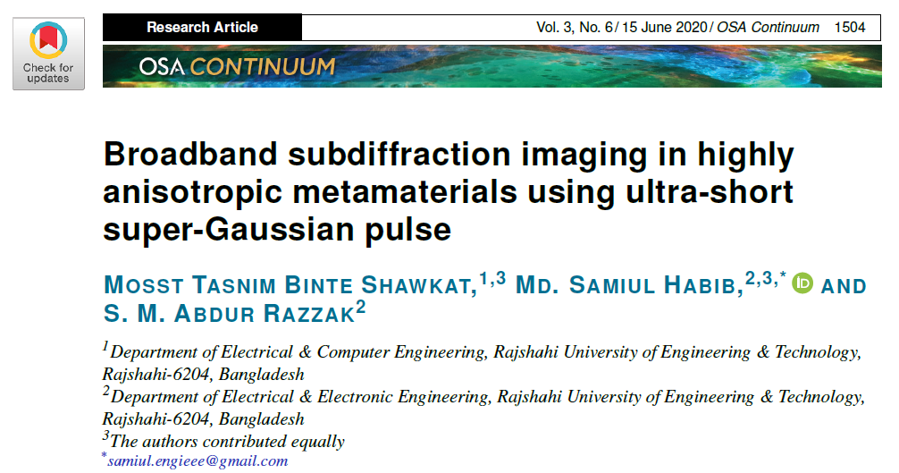
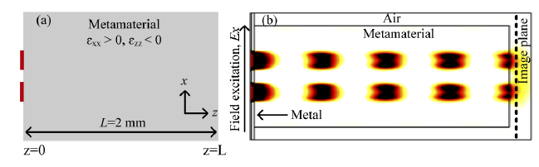
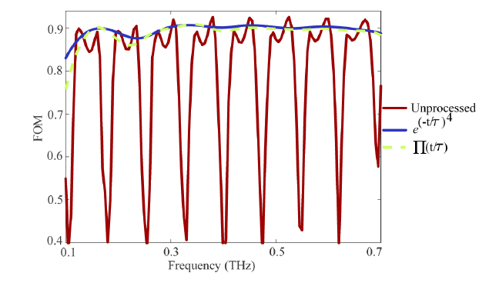
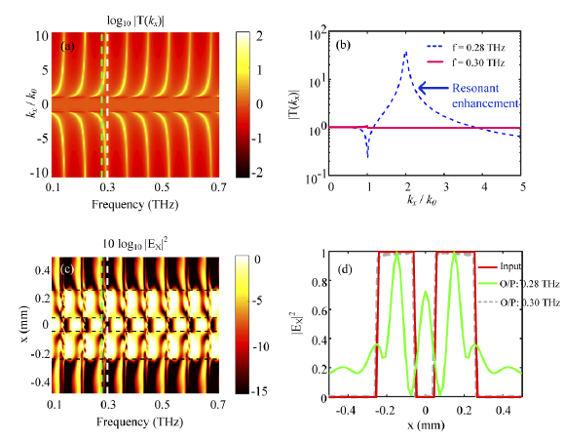
Literature Review (Cont..)
schematic of the highly anisotropic metamaterial slab and Simulated propagation of light
FOM
Contributions
Proposes ultra-short super-Gaussian windowing function as post-processing method
Minimizes resonant behavior and improves image quality
Improves imaging over a broad frequency band
Research gaps
The imaging properties of 3D metamaterial structures
Practical implications
2D map of the transmission coefficient and as a function of normalized spatial frequency

Slide 9
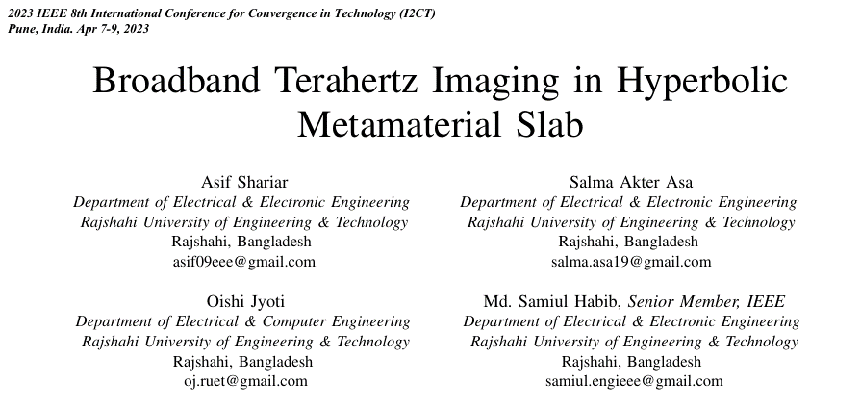
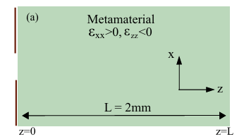
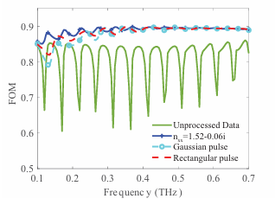
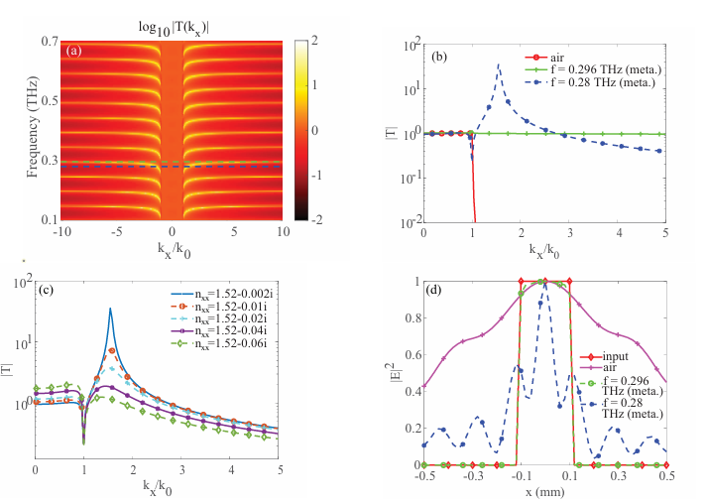
Literature Review (Cont..)
schematic of the highly anisotropic metamaterial slab and Simulated propagation of light
FOM
Contributions
Improves imaging quality adjusting the refractive index
Minimizes resonant behavior and improves image quality
Improves imaging over a broad frequency band
Research gaps
The imaging properties of 3D metamaterial structures
Practical implications
2D map of the transmission coefficient and as a function of normalized spatial frequency

Slide 10

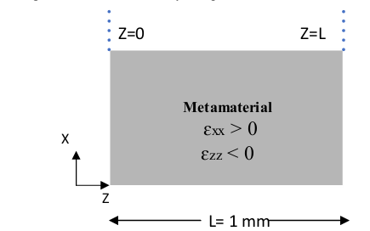
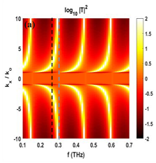
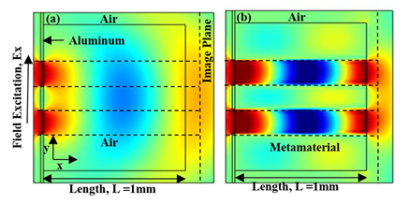
Literature Review (Cont..)
Schematic of a homogenized metamaterial slab
Contributions
Transmission coefficient spatial
frequencies over 0.1 THz to 0.7 THz
Proposes an analytical model and the transfer matrix method (TMM)
Describes hyperbolic metamaterials for sub-diffraction imaging at THz frequencies
Discusses the limitations of traditional imaging systems in supporting high spatial frequencies
Research gaps
Comprehensive analysis
Practical applications
Scalability or manufacturability
Field propagation through (a) isotropic slab (b) homogenized
metamaterial slab.
Page | 10

Slide 11
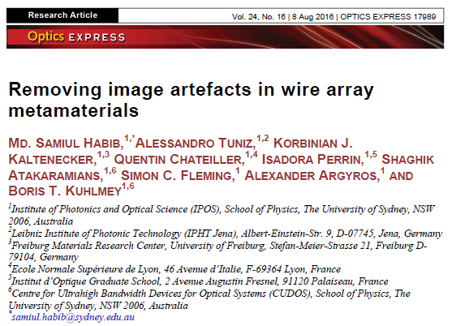
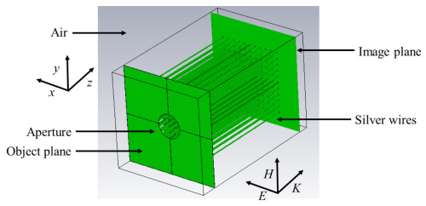
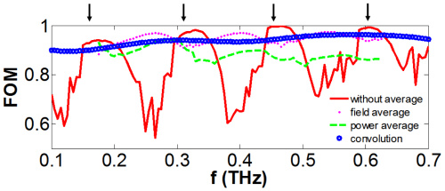
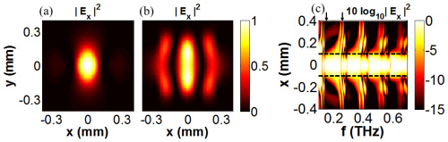
Literature Review (Cont..)
Geometry of wire array metamaterial
FOM
Contributions
Proposes three techniques to reduce image artifacts: convolutional, field averaging, and the power averaging method
Improves resolution of hyper lenses and hyperbolic media endoscopes
Research gaps
Dispersion relation for imaging devices
Trade-offs associated with the use of transverse polarizations
Simulated 2D image of the electric field at (a) 0.15 THz, and (b) 0.26 THz
(c) Simulated electric field intensity as a function of position and frequency
at the output of a 1 mm wire array metamaterial
Page | 11

Slide 12
Objectives
To design a hyperbolic metamaterial slab for sub diffraction imaging.
To validate theoretical and analytical modeling through simulation.
To implement effective post-processing method.
Page | 12

Slide 13
Methodology
Theoretical Modeling
Analytical Modeling
Double Slit Simulations
Numerical Post processing method
Performance Analysis
Page | 13

Slide 14
Model & Results
Theoretical modeling
The effective permittivities in the perpendicular (𝜀⊥) and parallel (𝜀∥) directions are determined using equations (1.1) and (1.2) respectively [1]:
Out-plane effective permittivity, 𝜀∥ = $\text{f}ε\text{m}\text{ + (1 − }\text{f}\text{ )}ε\text{d}$
(1.1)
In-plane effective permittivity, 𝜀⊥ = $\frac{\text{(1 + }\text{f}\text{)}ε\text{m}ε\text{d}\text{ + (}\text{1 − }\text{f}\text{ )}ε\text{d}\text{2} }{\text{(}\text{1 − }\text{f}\text{ )}ε\text{m} \text{+} \text{(}\text{1}\text{ − }\text{f}\text{)}ε\text{d}}$
(1.2)
Here, 𝜀⊥= 𝜀_{𝑥𝑥} = 𝜀_{𝑦𝑦} represents in-plane permittivity, whereas, 𝜀∥ = 𝜀_{𝑧𝑧} represents out-of-plane permittivity.
[1] A. Kannegulla and L-J. Cheng, "Subwavelength focusing of terahertz waves in silicon hyperbolic metamaterials," Optics Letters, Vol. 41, No. 15, pp. 3539-3542, Jul. 2016.
Page | 14

Slide 15
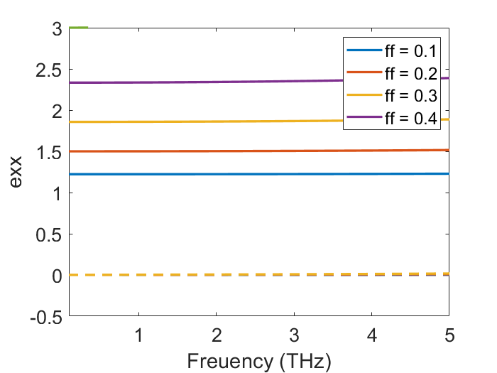
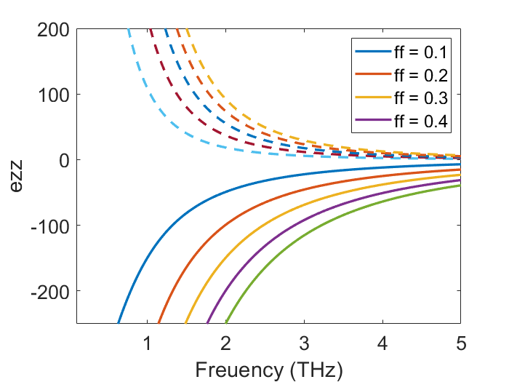
Model & Results
Theoretical modeling
Fig. 07: Plot Out-of-plane effective permittivity 𝜀∥ and in-plane effective permittivity 𝜀⊥ for Germanium
Page | 15

Slide 16
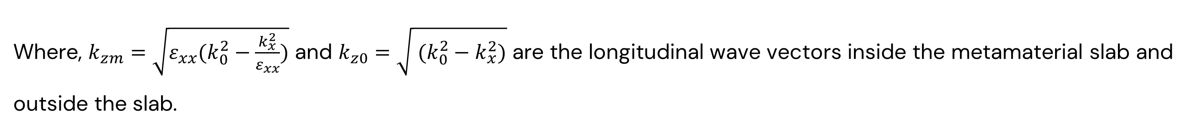
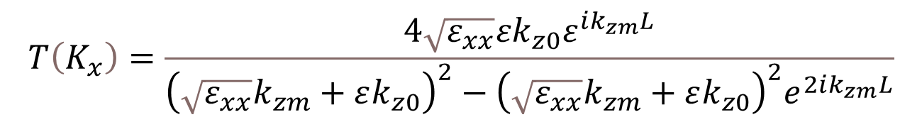
Model & Results (Cont…)
Theoretical modeling (Cont…)
The transmission coefficient calculated using the transfer matrix method.
We further utilized the obtained in-plane permittivity and out-of-plane permittivity to obtain the transmission coefficient within the frequency range spanning from 0.10 to 0.70 terahertz (THz), expressed in equation (1.3) [2]:
$$T\left(K_{x}\right)=\frac{4\sqrt{ε_{xx}}εk_{z0}ε^{ik_{zm}L}}{{\left(\sqrt{ε_{xx}}k_{zm}+εk_{z0}\right)}^{2}−{\left(\sqrt{ε_{xx}}k_{zm}+εk_{z0}\right)}^{2}e^{2ik_{zm}L}}$$
(1.3)
Where, $k_{zm}=\sqrt{ε_{xx}(k_{0}^{2}−\frac{k_{x}^{2}}{ε_{xx}})}$ and $k_{z0}=\sqrt{ (k_{0}^{2}−k_{x}^{2})}$ are the longitudinal wave vectors inside the metamaterial slab and outside the slab.
[2] M. Tasnim, B. Shawkat, M. S. Habib, and S. A. Razzak, "Broadband subdiffraction imaging in highly anisotropic metamaterials using ultra-short super-Gaussian pulse," OSA Continuum, vol. 3, no. 6, pp. 1509-1519, Jun. 2020..
Page | 16

Slide 17
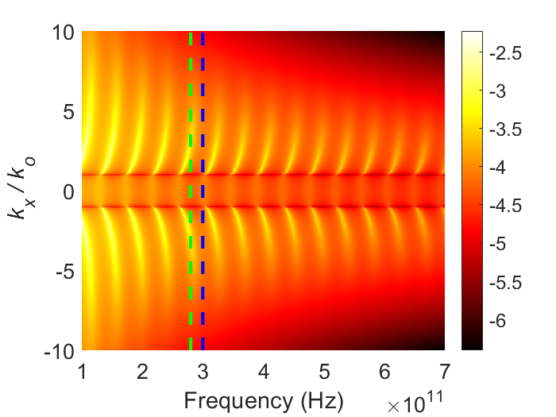
Model & Results (Cont…)
Theoretical modeling (Cont…)
Fig. 08: 2D map of the transmission coefficient for Germanium
Page | 17

Slide 18
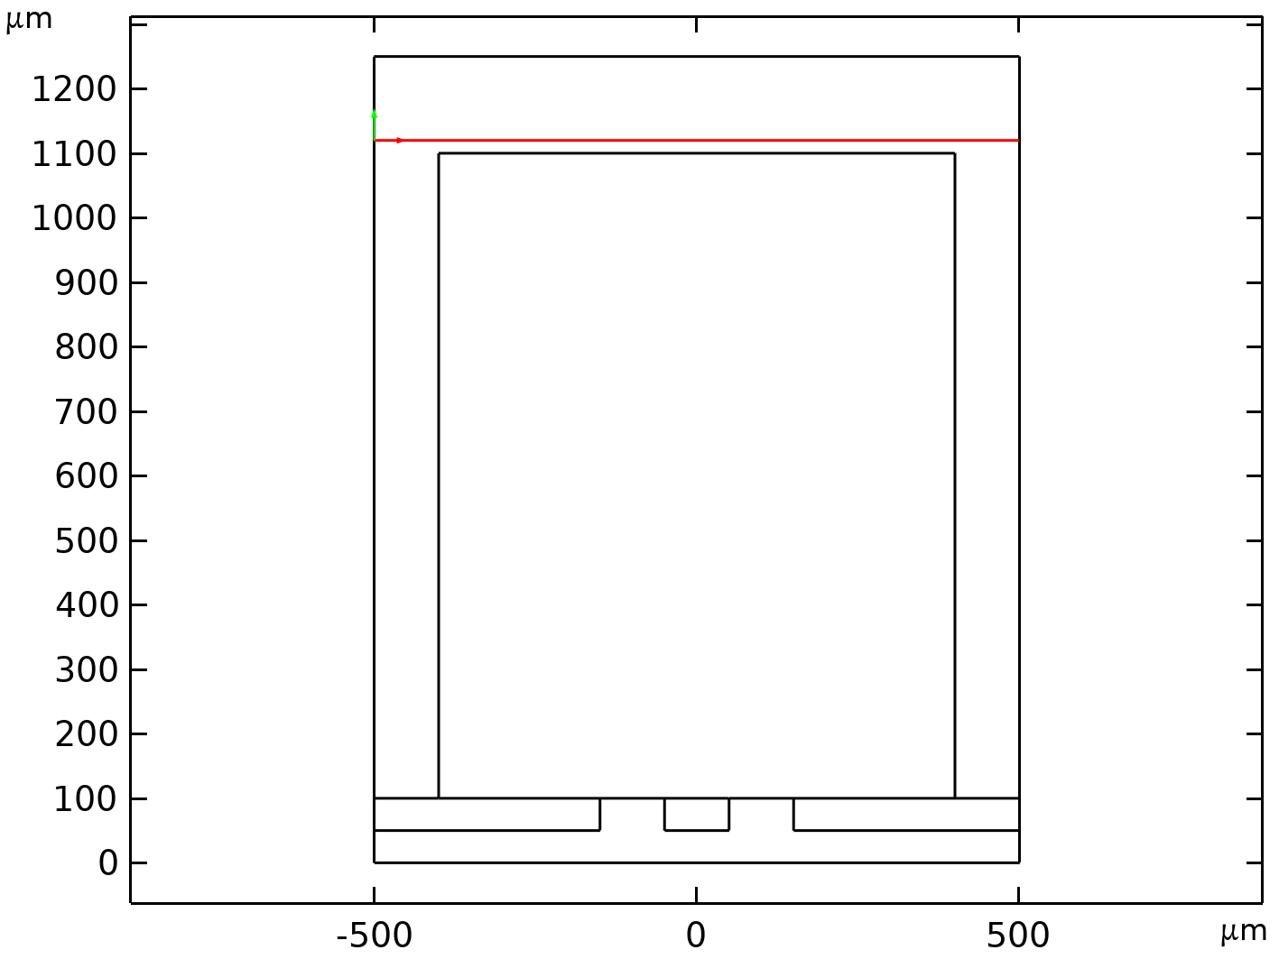

Model & Results (Cont…)
Analytical modeling
Image plane
Metamaterial
$$ε_{xx}>0,ε_{zz}>0$$
Air
Air
Slab length
Double Slit
Metal
Metal
Field Excitations
Fig.09: 2D schematic of the double slit metamaterial slab for slab length of 1000um.
Page | 18

Slide 19
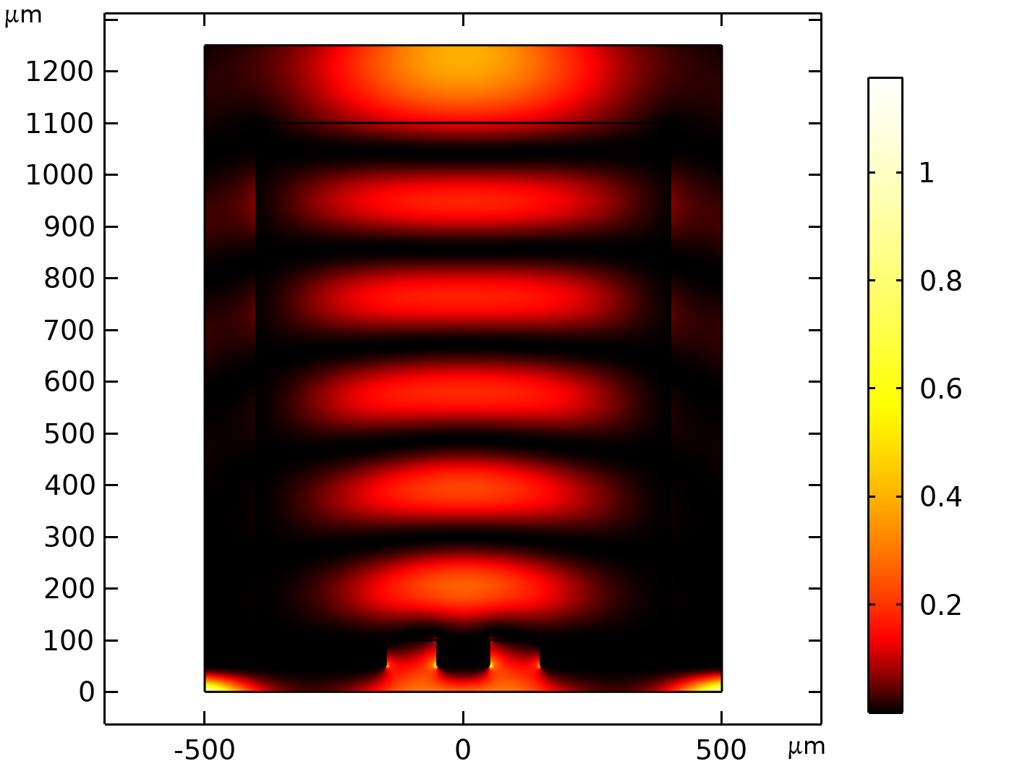
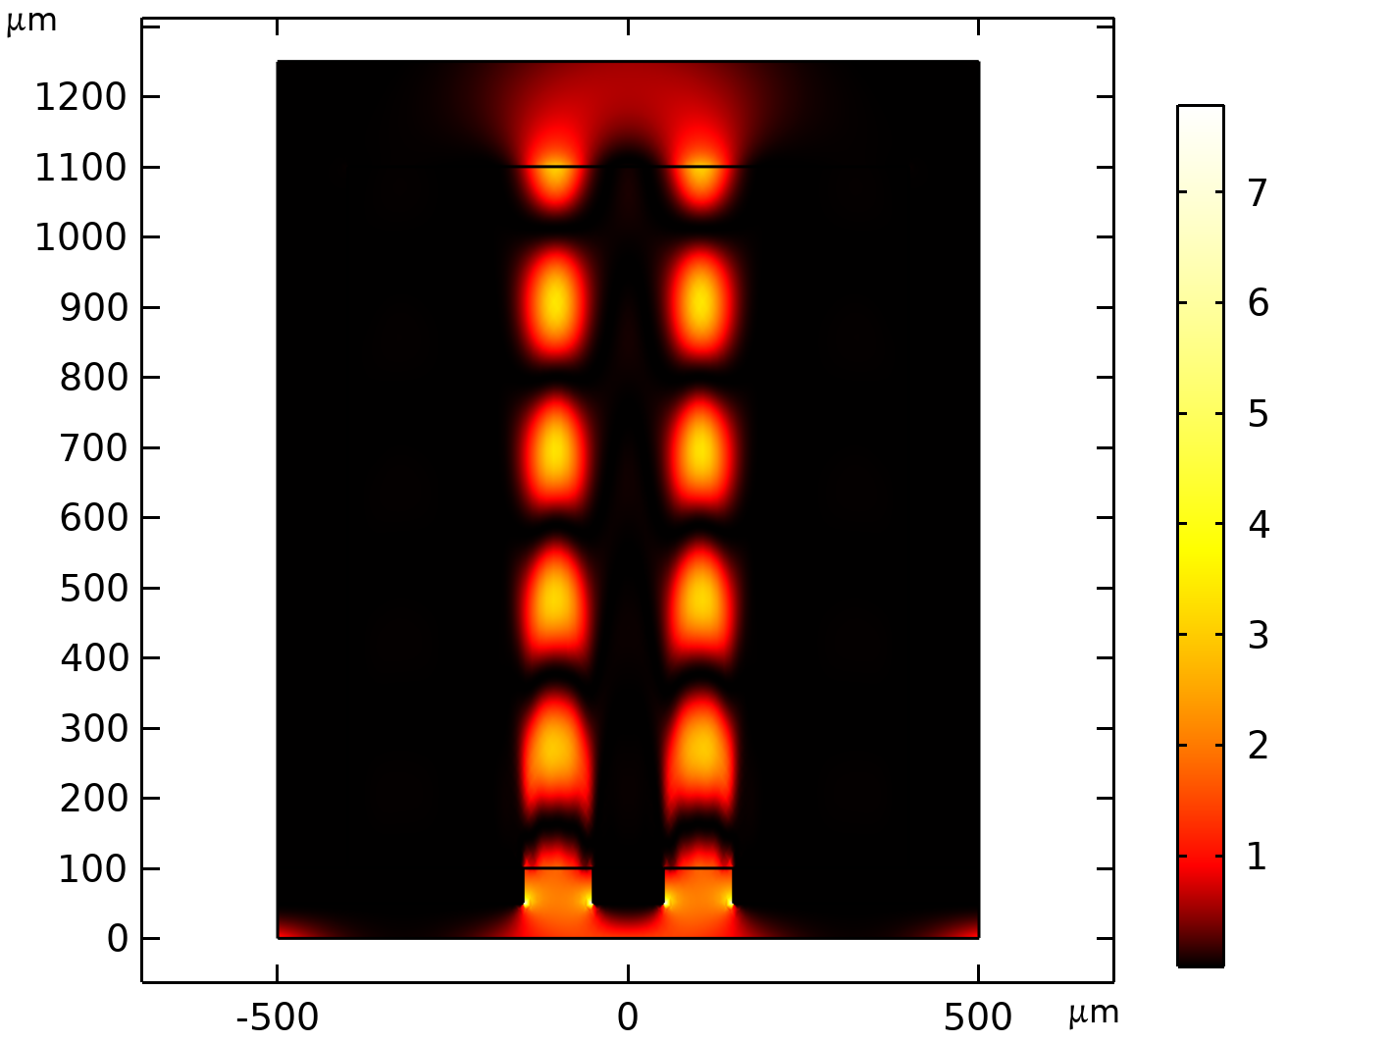
Model & Results (Cont…)
Double slit simulations
k
k
H
(a) Glass
H
(b) Metamaterial
E
E
Fig. 10: Simulated light propagation through (a) glass and (b) metamaterial medium
Page | 19

Slide 20
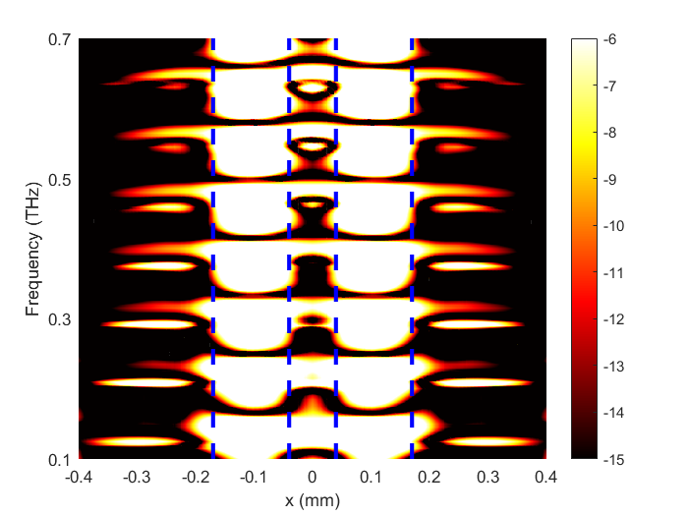
Model & Results (Cont…)
Double slit simulations (Cont…)
(b) MATLAB generated figure for 1 mm long slab
(a) Simulated light propagation through a 1mm long double slit metamaterial
Fig. 11: Double Slit Simulation for Metamaterial Medium.
Page | 20

Slide 21
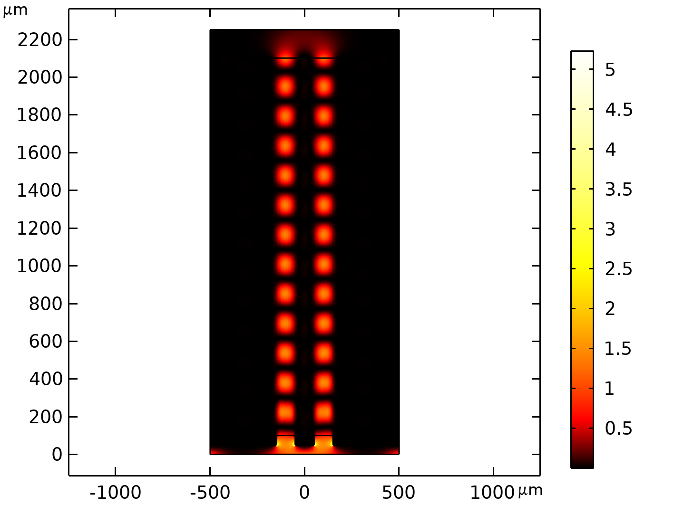
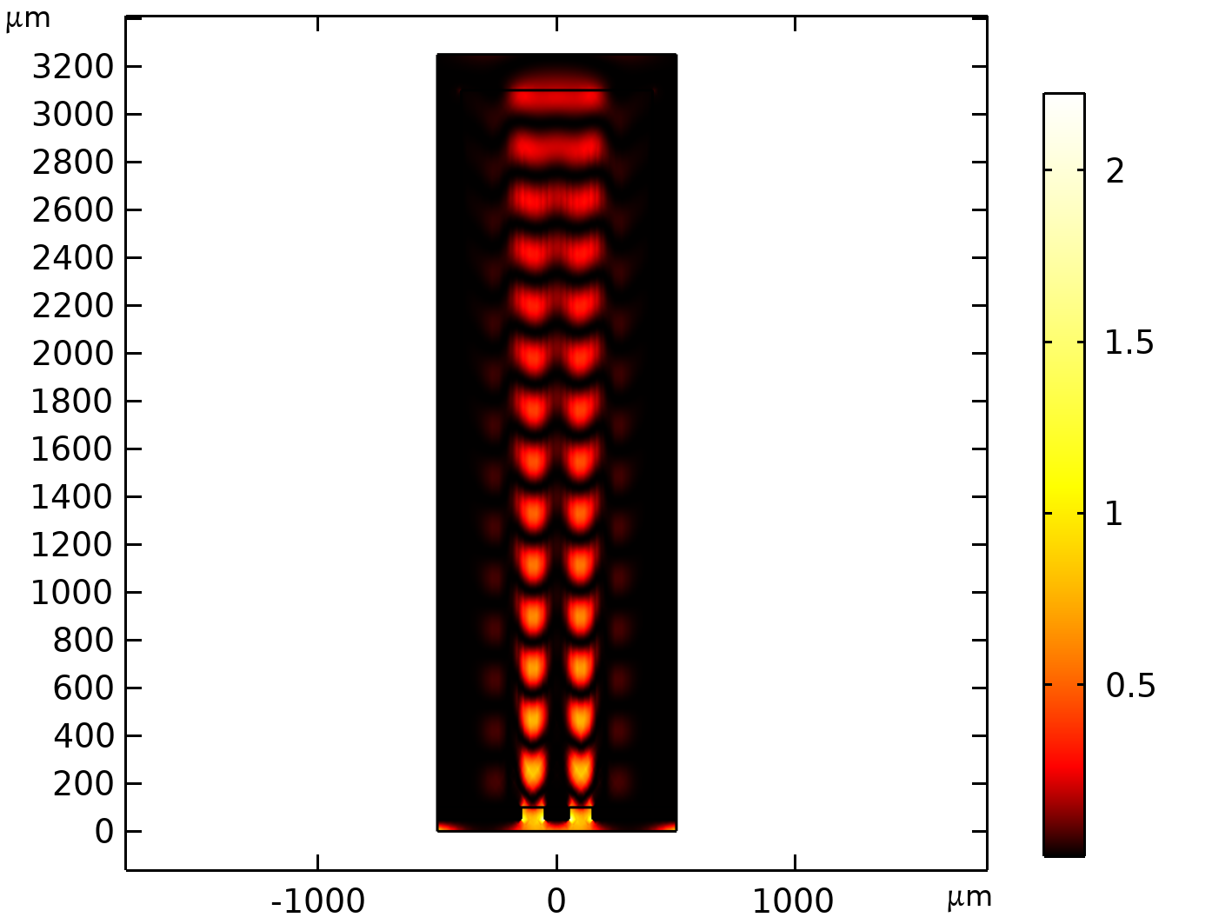
Model & Results (Cont…)
Consequence of varying slab length
k
k
H
(a) Slab length 2 mm
H
(b) Slab length 3 mm
E
E
Fig.12: Double Slit Simulation for slab length (a) 2 mm and (b) 3 mm.
Page | 21

Slide 22
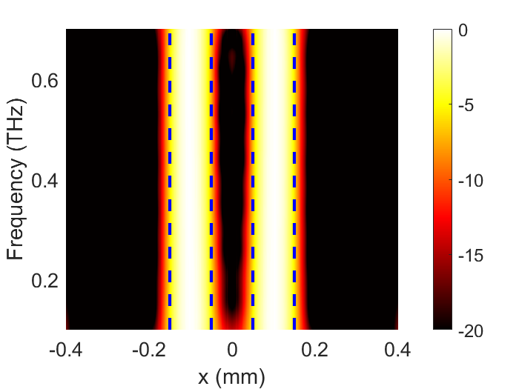
Model & Results (Cont…)
Numerical post processing method
(a) Frequency-dependent intensity profile calculated.
(b) Calculated intensity profile after Post Processing
Fig.13: Frequency-dependent intensity profile and Calculated intensity profile after Post Processing.
Page | 22

Slide 23
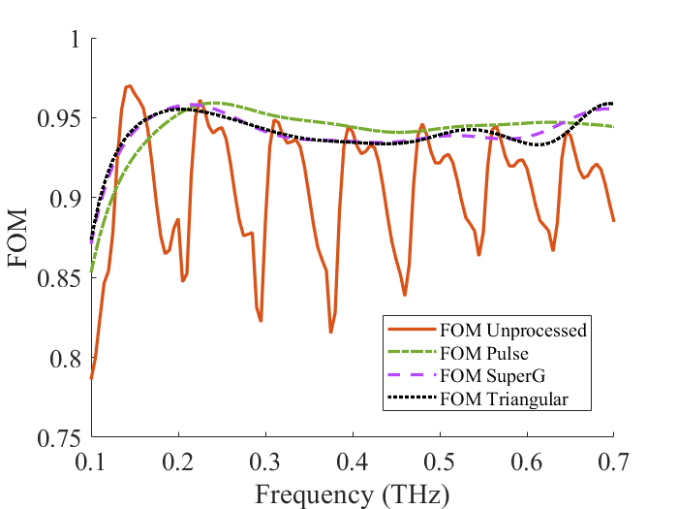
Model & Results (Cont…)
Performance analysis
Fig.14: Performance analysis using Figure of Merit.
Page | 23

Slide 24
Future works
This research can be expanded to:
Improve the design of hyperbolic metamaterial slabs for better dispersion and bandwidth performance.
Enhance THz image reconstruction using advanced machine learning and image processing methods.
Use THz imaging more effectively in biomedical or military fields for better precision and accuracy.
Page | 24

Slide 25
References
[1] | A. Kannegulla and L-J. Cheng, "Subwavelength focusing of terahertz waves in silicon hyperbolic metamaterials," Optics Letters, Vol. 41, No. 15, pp. 3539-3542, Jul. 2016.
[2] | M. Tasnim, B. Shawkat, M. S. Habib, and S. A. Razzak, "Broadband subdiffraction imaging in highly anisotropic metamaterials using ultra-short super-Gaussian pulse," OSA Continuum, vol. 3, no. 6, pp. 1509-1519, Jun. 2020.
[3] | A. Shariar, S. A. Asa, O. Jyoti, and M. S. Habib, “Broadband terahertz imaging in hyperbolic metamaterial slab,” in proceedings of 2023 IEEE 8th International Conference for Convergence in Technology (I2CT). IEEE, 2023, pp. 1–5.
[4] | M. S. Hossain and S. A. Hossain, “Hyperbolic metamaterial for sub-diffraction imaging at thz frequencies,” in proceedings of 2019 3rd International Conference on Electrical, Computer & Telecommunication Engineering (ICECTE). IEEE, 2019, pp. 237–239.
[5] | M. S. Habib, A. Tuniz, K. J. Kaltenecker, Q. Chateiller, I. Perrin, S. Atakaramians, S. C. Fleming, A. Argyros, and B. T. Kuhlmey, “Removing image artefacts in wire array metamaterials,” Optics Express, vol. 24, no. 16, pp. 17 989–18 002, 2016.
Page | 25

Slide 26
Thank You
Page | 26

